Slide 1

AstroSage Call Center Optimization Strategy
Strategic Investment Allocation: Maximizing Call Center Efficiency & Profitability
A Data-Driven Approach for AstroSage (₹1 Crore Investment)
Presented by: Shubham Prasad Kuiri
Date: November 28, 2025

Slide 2
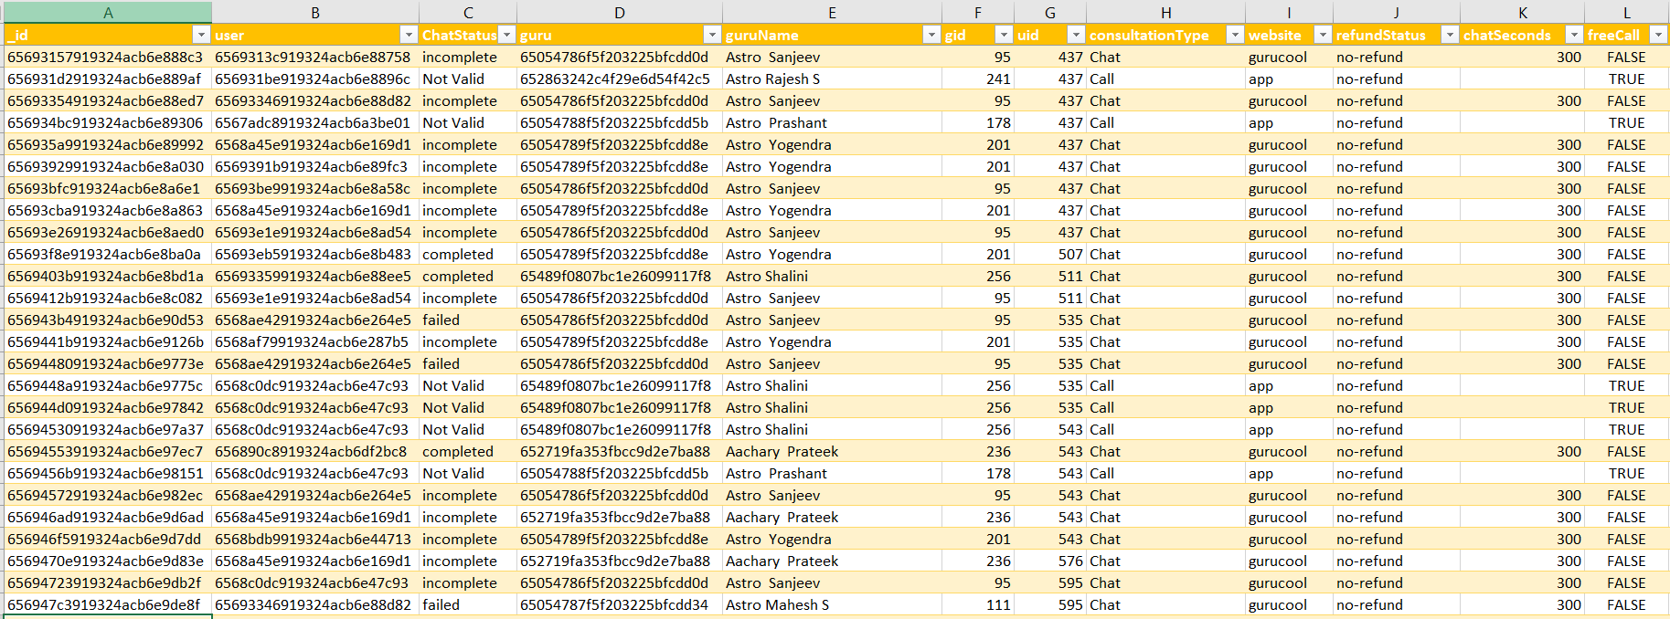
Problem statement
AstroSage has received a 1 crore investment and aims to optimize its call center operations. The goal is to determine how to allocate this investment to maximize operational efficiency, customer satisfaction, and profitability. The analysis will consider historical call data, performance metrics, and market trends to make informed decisions.

Slide 3

About Astrosage
Trusted online astrology platform designed to provide clarity and confidence in life’s journey.
Dedicated to making astrology accessible to everyone with meaningful insights into life, relationships, and career.
Offers direct connections with experienced astrologers via live chat, call, or video consultations.
Provides a variety of personalized services, including horoscope readings, Vedic astrology, and numerology.
Focuses on delivering tailored guidance to meet the unique needs of every individual.

Slide 4
Introducing AstroSage & The Service Model
AstroSage: Bridging Digital Access to Ancient Wisdom
Company Overview: AstroSage is a leading digital platform providing personalized astrology and consultation services.
Core Business Model: Revenue is heavily reliant on real-time, one-on-one call consultations between users and verified astrologers (Gurus).
Criticality of Call Center: The call center acts as the direct revenue engine and the primary touchpoint for customer experience (CX). Operational efficiency directly translates to profitability.
The Challenge: High demand and technical/process bottlenecks are currently limiting the system’s ability to convert potential consultations into revenue.

Slide 5
ATTRIBUTES USED
_id: Unique identifier for each record.
user: User ID associated with the record.
chatStatus: Status of the chat.
guru: Unique identifier for the guru.
guruName: Name of the guru.
gid: Guru ID.
uid: User ID.
consultation Type: Type of consultation.
website: Source of the consultation.
Refund Status: Indicates if the session is refundable or not.
is WhiteList User: Boolean indicating if the user is whitelisted.
chat Seconds: Duration of the chat in seconds.
queue: Boolean indicating if the session was queued.
FreeCall: Boolean indicating if the call was free.

Slide 6
ATTRIBUTES USED
Free Chat: Boolean indicating if the chat was free.
Year: The year the account is created.
Created_Date: The date when the account is created.
Created_Time: The time when the account is created.
CreatedAT: Original creation date and time.
updatedAt: Original update date and time.
__v: Version key.
statementEntryId: Identifier for the statement entry.
chatStartTime: Start time of the chat.
chatEndTime: End time of the chat.
timeDuration: Undefined, some technical data as per app.
callChannel: Channel used for the call.

Slide 7
ATTRIBUTES USED
calIvrType: IVR type used during the call.
callStatus: Status of the call.
CallSid: Unique identifier for the call session.
amount: Amount charged for the session.
astrologerCallStatus: Status of the astrologer during the call.
astrologerOnCallDuration: Duration of the astrologer's call.
astrologersEarnings: Earnings of the astrologer from the session.
netAmount: Net amount after deductions.
region: Region of the user.
userCallStatus: Status of the user's call.
userOnCallDuration: Duration of the user's call.
rating: Rating assigned based on the session's status.

Slide 8

Data Overview
Key Performance Indicators (KPIs)
Engagement: Over 26K monthly users.
Agents: 131 dedicated agents.
Revenue: Monthly revenue over 2 lakhs.
Investment: 1 crore investment for business optimization.
Data Cleaning and Preprocessing
Attribute Removal: Removed non-informative columns.
Data Consistency: Standardized guruName formatting.
Data Cleaning: Removed unwanted characters and handled missing values optimization.
Data Utilization
Business Analysis: Deep dive into AstroSage's business model.
Key Insights: Understand user behavior, internal challenges, and areas for improvement.
Investment Guidance: Identify strategic areas for resource allocation.

Slide 9
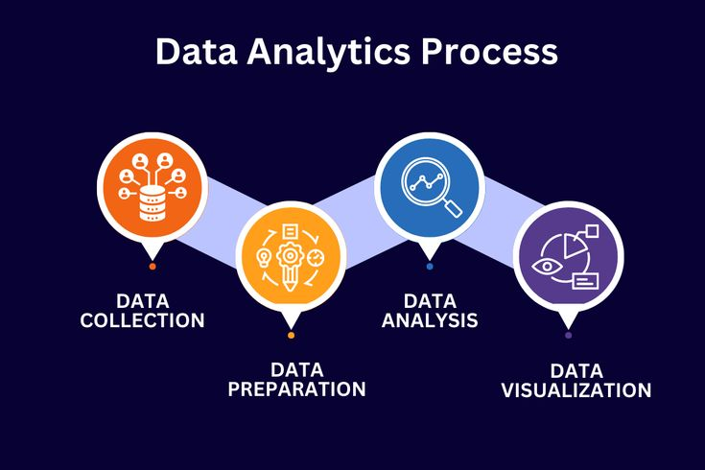
Analytical approach and Tool
Data Cleaning: Used spreadsheets functions like trim and Removing duplicates for data cleaning.
Data Enrichment: Added new variables using Date functions for better analysis.
Customer Segmentation: Applied SORT and FILTER functions to classify customers based on consultant type and time duration.
Used Pivot tables to analyze the performance of consultants over different category type and ratings recieved on basis of consultations from users.
Visualization: Created dynamic charts and dashboards for data representation, enabling interactive data exploration.

Slide 10
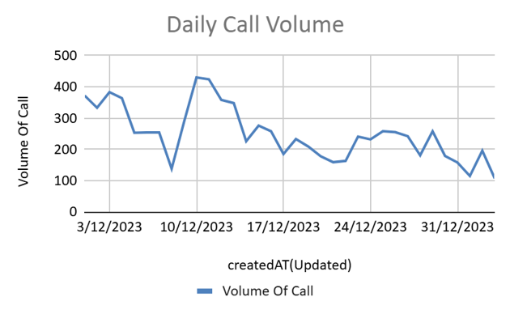
Average Call Handled Per Agent Per Day
Average Calls/Agent: 1.91/day, indicating low activity.
Potential Issue: Suggests low user base or traffic.
Compounding Problem: Declining call volume highlights business risks.
Urgent Action: Sustained decline poses critical challenges.
Temporary Solution: Boost marketing and offer incentives.

Slide 11
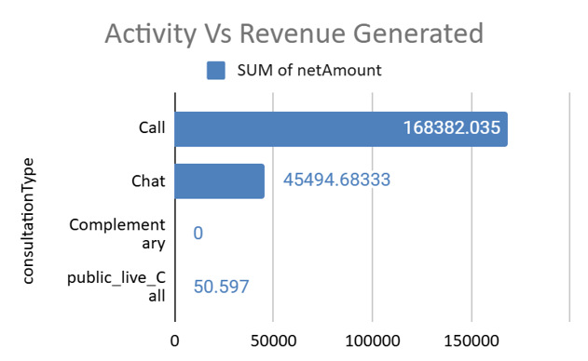
Chat/Call Revenue Analysis
Activity: Higher chat activity (19,514) compared to calls (8,505).
Revenue: Lower chat revenue (₹45,495) compared to calls (₹168,382).
Gap: Chat popularity doesn't translate to revenue.
Suggestion: Enhance the chat interface with instant horoscopes, follow-ups, and real-time document sharing to improve user satisfaction and retention.

Slide 12
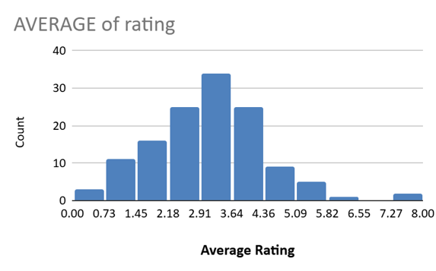
Average Rating Analysis
Indicator: Average user rating reflects user experience and likelihood of revisits.
Interpretation: Higher ratings indicate positive experiences. Lower ratings suggest negative ones.
Concern: Majority of ratings (below 3.64/8) indicate subpar user experiences.
Potential Issue: Agent-provided resolutions may be contributing to dissatisfaction.

Slide 13
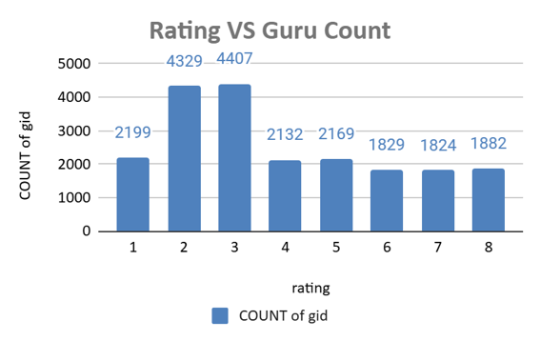
Ratings v/s Guru count analysis
Key Insights:
Majority of gurus are rated 2-4, peak at 3 (4,407 gurus).
Fewer gurus in ratings 5-8, indicating improvement potential.
Few gurus achieve top ratings.
Recommendations:
Provide training for gurus with ratings 2-4 to improve interactions.
Introduce performance-based incentives for higher ratings.

Slide 14
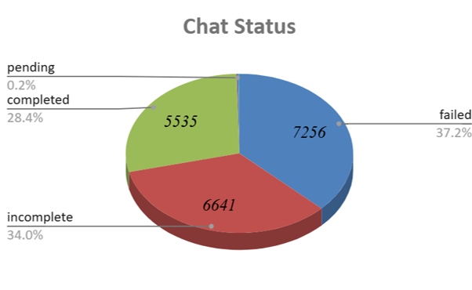
Chat Status Analysis
Key Insights:
High Failure & Incomplete Rates: Over 13,897 chats not resolved.
Opportunities for Improvement: Address reasons behind incomplete and failed chats.
Recommendations:
Improve Support Processes: Upgrade systems, train staff, reduce response times.
Implement Chat Automation: Use AI-powered chatbots for simpler queries.

Slide 15
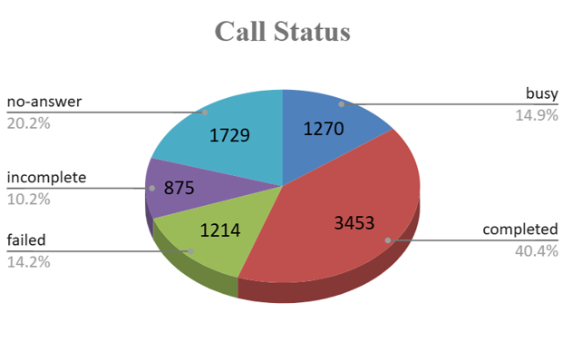
Call Status Analysis
Key Insights:
Success Rate: Only 40.4% of calls are successfully completed.
Improvement Areas: Address issues with "No Answer," "Busy," and "Failed" calls.
Recommendations:
Optimize Timing: Implement automated callbacks.
Enhance Queue Management: Expand agent availability or improve call routing.
Upgrade Systems: Strengthen infrastructure and provide advanced agent training.

Slide 16
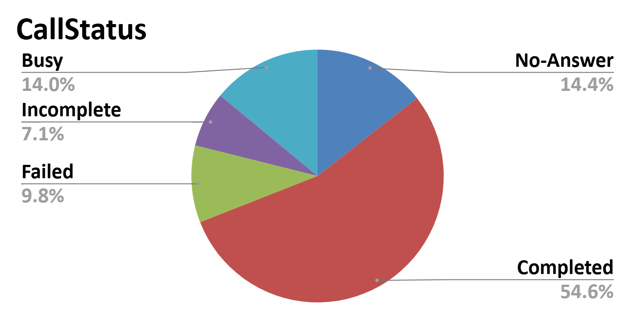
Majority of calls are completed, indicating system or agent efficiency.
Significant share of busy and incomplete calls — opportunity to improve call handling & routing.
Failed & no-answer calls also present — suggesting missed revenue and improvement area.
Conclusion: The highest return on investment (ROI) will come from addressing these immediate technical and capacity failures.

Slide 17
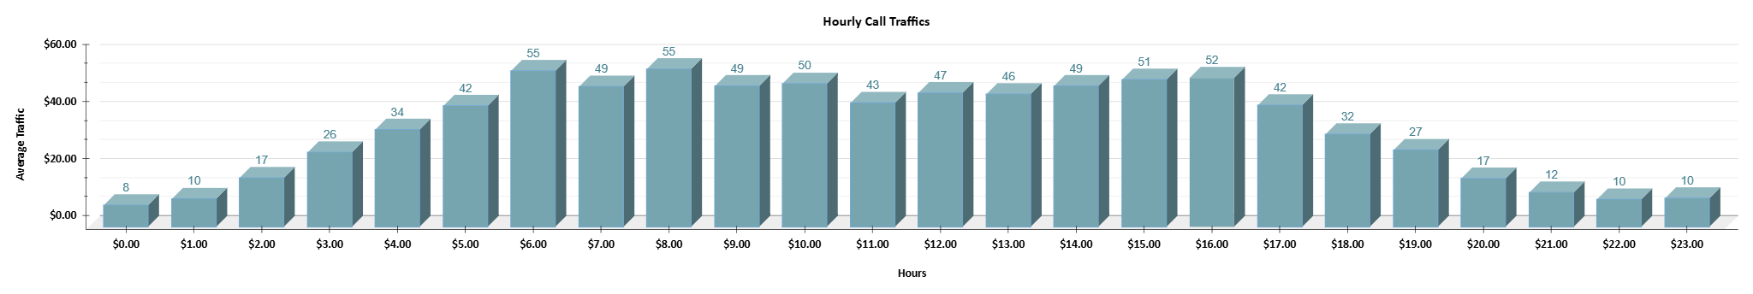
Hourly Load Patterns & Peak Hours
Actionable Insight: The staffing strategy must prioritize resource allocation to the 5 AM to 5 PM window, especially the early morning hours, to address the 14.0% 'Busy' calls.

Slide 18
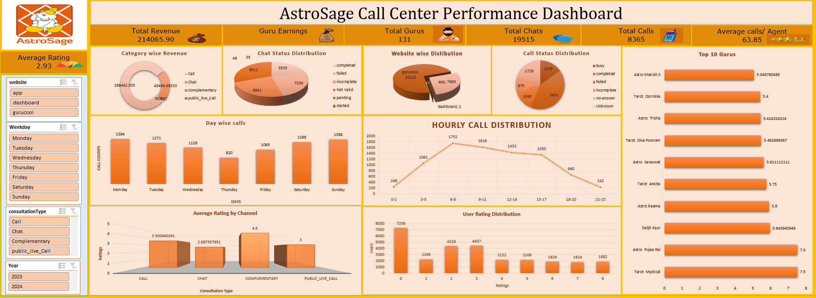
Consolidated Call Center Performance Dashboard

Slide 19
Recommendations
Implement AI-powered chatbot systems to automate basic queries and reduce agent workload.
Introduce analytics dashboards (Power BI/Tableau) for real-time performance monitoring.
Hire additional part-time or full-time agents during peak call periods.
Launch automated feedback surveys post-call to measure satisfaction in real time.
Automatically directs customer calls to the most suitable agent based on issue type, sentiment, or past interactions.
Uses AI to analyse tone, sentiment, and keywords in reviews and recorded calls, Detecting frustrated or unsatisfied customers early.
Focusing on call consultations can increase revenue and customers satisfaction.
Recognizing top consultants and organizing regular training will ensure consistent service quality.

Slide 20
Conclusion & Next Steps
Conclusion: A Path to Data-Driven Operational Excellence
Summary: The ₹1 Crore investment strategy is designed to create a stable, efficient, and profitable call center by prioritizing system fixes first (45% Tech), followed by skill enhancement (25%Training) and capacity alignment (20% Hiring).
Next Steps:
Approval: Secure sign-off on the ₹1 Crore investment and allocation strategy.
Vendor Selection: Initiate procurement for new technology and scheduling software.
Baseline Freeze: Lock down current KPI metrics to accurately measure ROI starting November 28, 2025.

Slide 21


